Slide 1
Complete Waste Estimation System -Udgir
Developed By –
Pranav Bansod Pranav Dange
Hrithika Charukula Rishabh Pattewar

Slide 2
Problem Statement
Udgir is a small city with a municipal council in the Latur district, which is located in the Indian state of Maharashtra and facing one the most common problem which even most of the big Cities face which is –
There is no definitive route which is followed for collection of Waste from respective areas and which often and in turn leads to waste not being collected at proper time and having really no definitive knowledge of exactly which area produce how much of Waste, for trips to be optimally scheduled
Not enough Waste being processed out of the total waste collected
According to officials of municipality of Udgir one of the reason that this is causing is the guess work and uncertainty in the amount of waste collected next day.
Proactively, getting an estimate of amount of Wet Waste will help officials to plan and make necessary arrangement for upcoming days. Ie. like making an compost, fertilizer etc

Slide 3
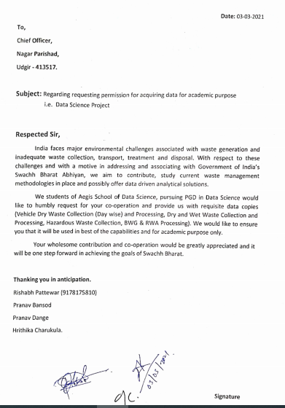
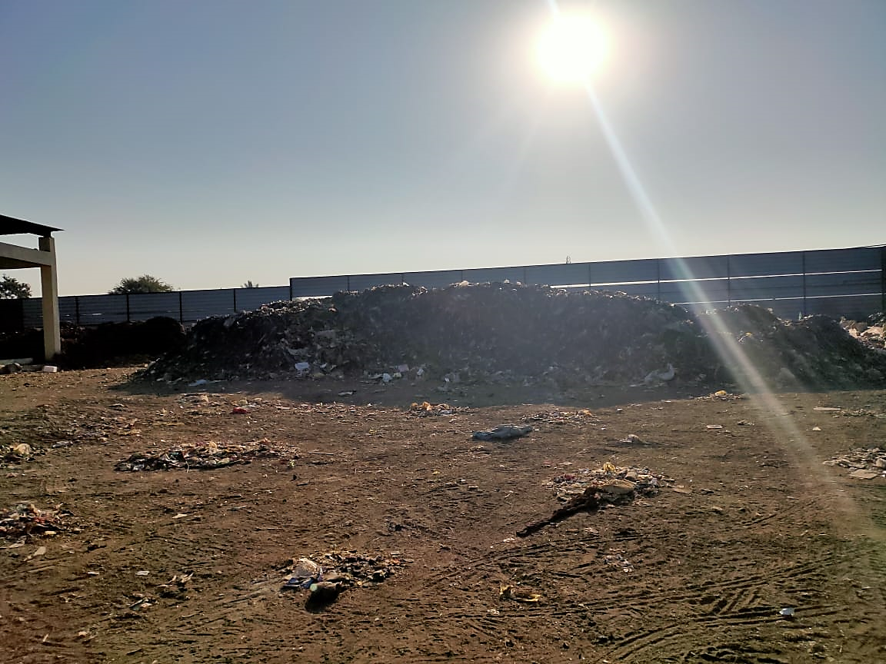
Data Collection – Permission and Site Visit

Slide 4
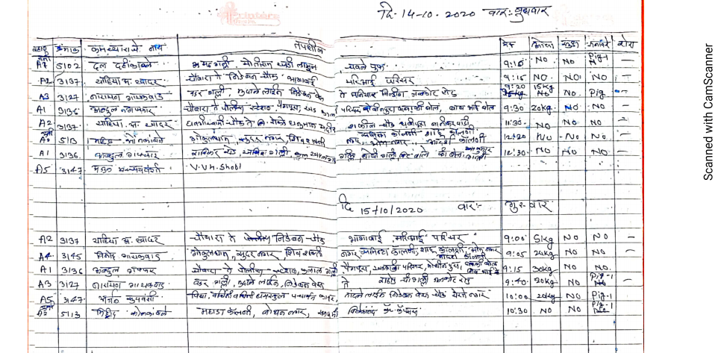
Data – For different Wards Sample Data in Raw format for Ward A
Similarly, there are total 4 Wards and data is present for Ward A, B, C and D

Slide 5
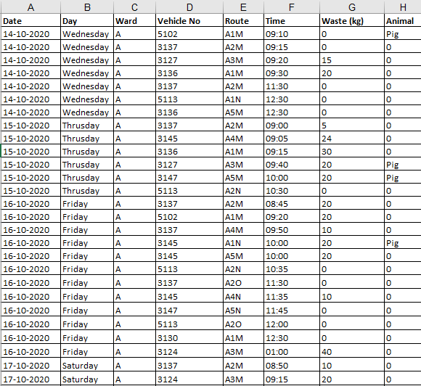
Encoded Data – In Excel. Making Sense of Data
Date, Day, Ward, Vehicle Number (from where the Waste is collected from every Area)are entered as it is and then for Route we have defined specific labels.
That means – Every Route from where the Waste is picked are set of Locations Predefined.
Time - Recorded time at which Data is dumbed in the Ground
Waste (Kgs ) is the waste the Vehicle brought
Animal found in that area for that Location/Route by that Vehicle Number

Slide 6
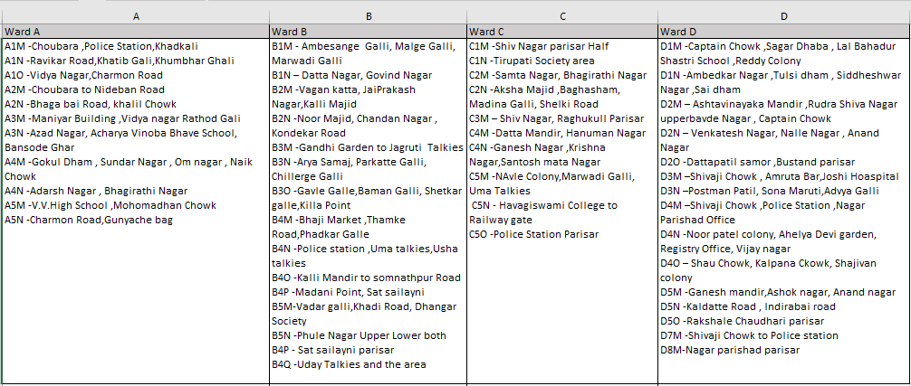
Encoded Data – In Excel. Making Sense of Data
Following is the way we defined our label for each Route -

Slide 7
Data Preprocessing, Data Cleaning and EDA
Of course, the manually entered Data had many typing errors as well the data in the raw format had null values, zeros and blank spaces which are treated
Missing Value Imputation and Data Cleaning is done (Detailed Explanation in the ipynb file)
After, the same EDA is done – Univariate and Bivariate Analysis, plots and graphs which focusses and aims at finding the pattern, distribution and type of Data

Slide 8
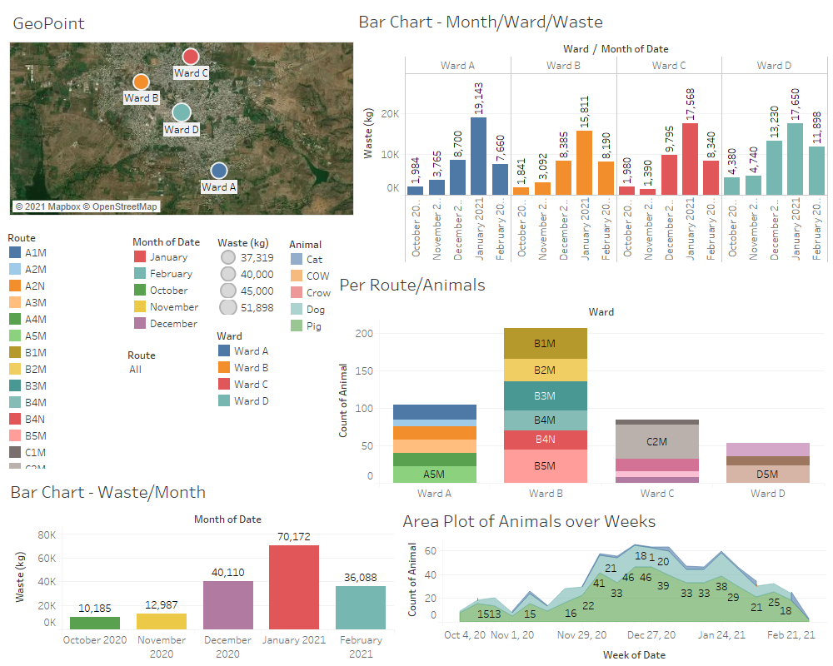
Making Sense of the Data – Bird’s Eye View

Slide 9
Using Regression Model Approach
Model | R2 - Score
Ward A :
Linear Regression | 0.38
After applying Feature Selection | 0.36
Ward B :
Linear Regression | 0.31
After applying Feature Selection | 0.29
Ward C :
Linear Regression | 0.31
After applying Feature Selection | 0.31
Ward D :
Linear Regression | 0.45
After applying Feature Selection | 0.45

Slide 10
Classification model
Ward A :
Logistic Regression | 28.6 %
XG Boost Classifier | 74.76 %
Random Forest Classifier | 71.59 %
Ward B :
Logistic Regression | 28 %
XG Boost Classifier | 81.36 %
Random Forest Classifier | 78.42 %
Ward C :
Logistic Regression | 25.6 %
XG Boost Classifier | 74.32 %
Random Forest Classifier | 71.42 %
Ward D :
Logistic Regression | 20.5 %
XG Boost Classifier | 67.6 %
Random Forest Classifier | 63 %

Slide 11
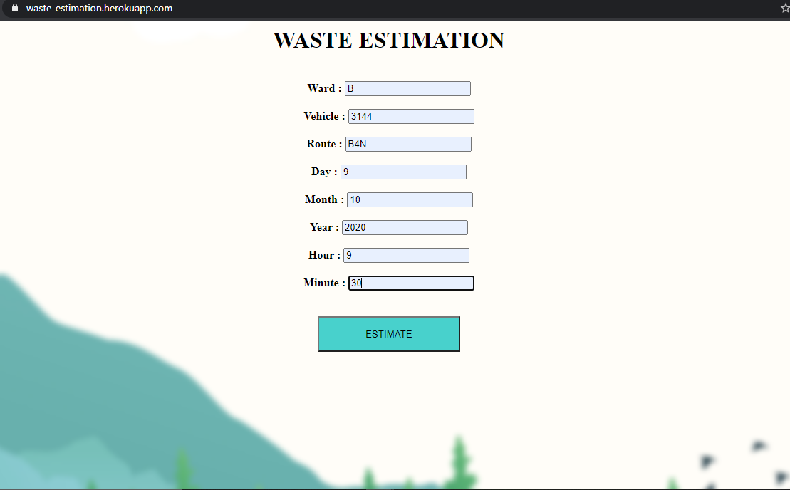
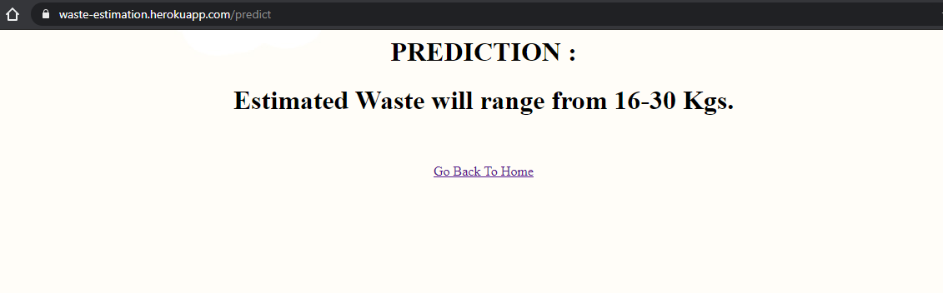
Conclusion
Given, Ward, Vehicle Number, Route, and other details we offer solution which enables any employee of the Municipality to optimize and automate planning of waste collection routes.
https://waste-estimation.herokuapp.com

Slide 12
Future Scope
Optimal Route Planning for waste collection using Operation Research Techniques
Asset Management for trash bins for effective management
Eventually setting up the system to – Asset Management, Waste Monitoring and Route Planning solution

